Slide 1
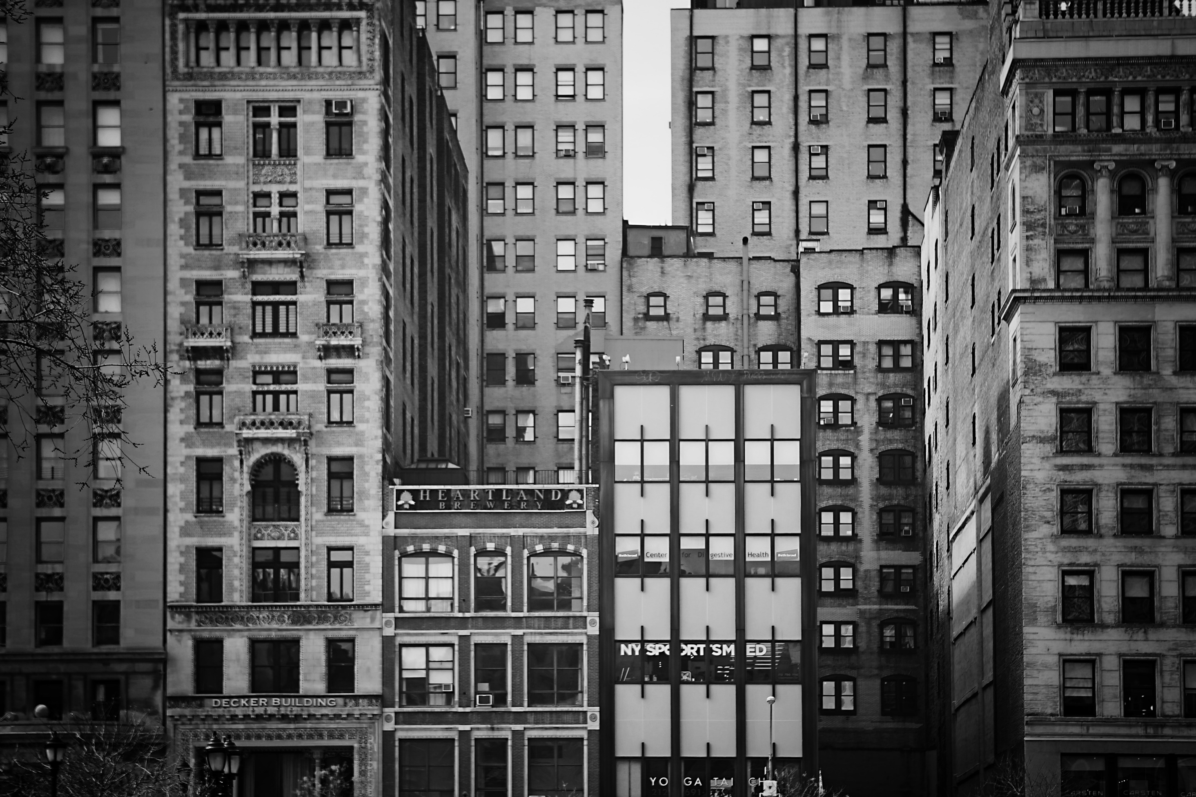
Aging in Uncertainty:
The Growing Housing Crisis for BC Seniors

Slide 2
We acknowledge the City of Vancouver is located on the unceded traditional territories of the xʷməθkʷəy̓əm (Musqueam), Sḵwx̱wú7mesh (Squamish), and səlilwətaɬ (Tsleil-Waututh) Nations.

Slide 3
Seniors Housing Working Group
This presentation is based on a report that was prepared by United Way British Columbia and the Housing Working Group, a committee of the Community Based Seniors’ Services (CBSS) Leadership Council
Report was developed in response to concerns from frontline CBSS who have been alarmed in recent years by the escalating number of seniors who are homeless or on the verge of homelessness

Slide 4
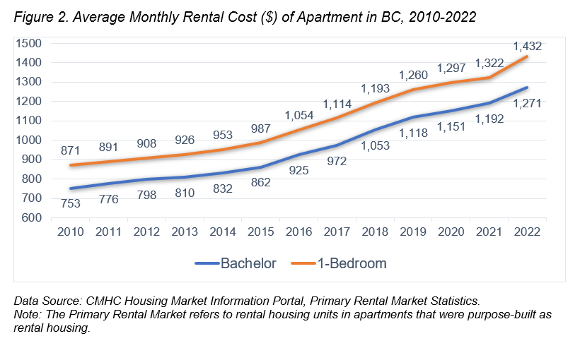
Notes:
The average monthly rental cost of a 1-bedroom apartment increased from $871 in 2010 to $1,432 in 2022 (a 64% increase).

Slide 5
Notes:
Low-income rates for seniors in BC (15.2%) are now almost double that for any age group, which is a dramatic reversal from three decades ago when seniors had the lowest low-income rates of any age group.

Slide 6
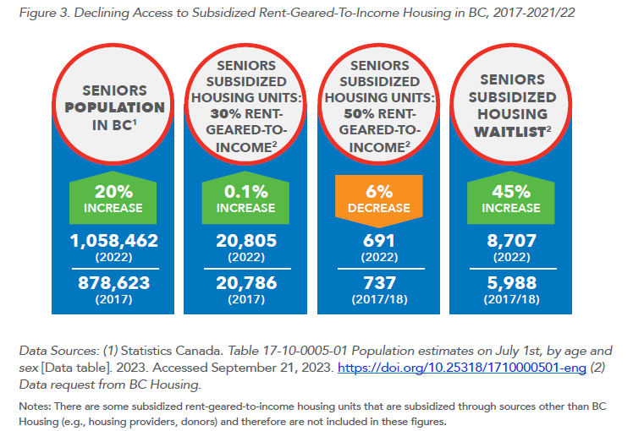

Slide 7
Greater Vancouver Statistics
Homeless Seniors (55+)
Seniors (65+) at Risk of Homelessness
In the 2023 Homeless Count there were 568 homeless seniors (over double the amount in 2008)
216 of the seniors experienced first-time homelessness
16% of the indigenous and 25% of the non-indigenous homeless populations were seniors
1 in 5 senior-led renter households (12,295) spend more than 50% of their income on housing

Slide 8
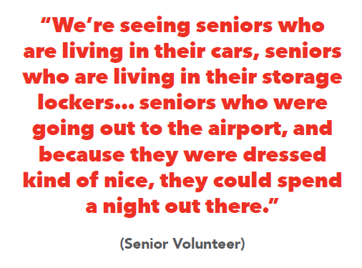
Living in unsheltered, substandard or unsafe housing situations

Slide 9
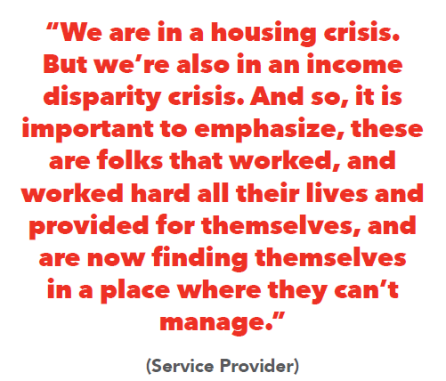
Homeless for the first time in their lives at age 60 or 70

Slide 10
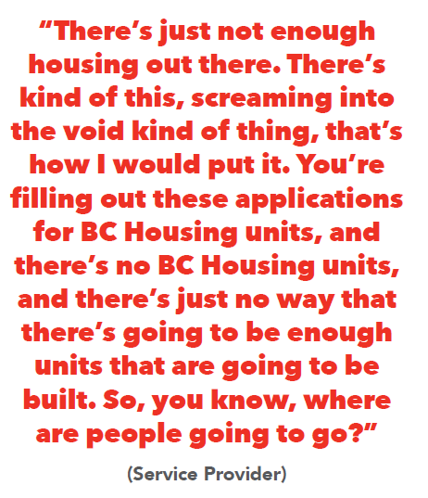
Continuum of Housing Supports Required
Growing need for housing navigation services for seniors
The current shelter system is not serving seniors well
Seniors need access to safe and supported low-income rental housing

Slide 11
Report Recommendations
Notes:
Our comprehensive report outlines six overarching goals and sixteen specific recommendations aimed at fostering housing affordability for seniors and other low-income individuals across British Columbia. Within these recommendations, we showcase positive actions already undertaken by the BC Government, municipalities throughout the province, and various community-based organizations.
The first three goals of our recommendations center on the critical necessity for increased low-income rental housing stock in BC, benefiting residents of all age groups. The report's remaining three goals hone in on the unique housing requirements of the senior population. This dual-focus approach underscores our commitment to addressing the broader housing crisis while tailoring solutions to meet the specific challenges faced by seniors.

Slide 12
Shelter Aid for Elderly Renters (SAFER)
Recommendation 4.1: The Provincial Government increase SAFER amounts to ensure they accurately reflect the rental market, and thereafter annually review and adjust the amounts. Steps should also be taken to expand and streamline access to the program.
Key concern is that rent ceilings are not aligned with the actual rental market
E.g., Rent ceiling for the Greater Vancouver is $803 while average 1-bedroom was $1,543 leading to a rent gap of $740

Slide 13
Protecting Tenants
Recommendation 2.2: Provincial and local governments must take steps to protect the housing security of renters in the private market, including implementing vacancy controls (i.e., limits on rent increases between tenancies) and strengthening tenant protections. These must be implemented in a way that avoids unintended negative consequences for non-profit housing providers.
Need for vacancy control: In Greater Vancouver the average rent for a vacant unit is 43% higher than for occupied units
Municipal tenant assistance policies (e.g., Burnaby) and requirements to register evictions can also help to protect tenants

Slide 14
Advocacy to Local Government
Recommendation 1.2: Local governments develop and utilize all the tools that are available to them, building on best practices from local governments in BC and elsewhere, to support non-profit developers to build low-income rental housing.
Examples of policy levers: property tax exemptions, waiving permitting fees, rental only or inclusionary zoning
Recommendation 3.1: Local governments provide adequate and sustainable funding for the establishment of community tables/ coalitions/alliances to address housing and homelessness in local communities.
Groups such as 100 More Homes Penticton and the Alliance to End Homelessness in the Capital Region have been successfully advocating for local community-driven solutions

Slide 15
Supports for Vulnerable Seniors
Recommendation 5.1: The Provincial Government develop funding streams to support community-based organizations providing on-site tenant and social connection supports to vulnerable seniors living in low-income rental housing.
Examples of such programs currently exist such as Whole Way House and the SRO Hub model
Recommendation 6.1: The Ministry of Mental Health and Addictions continue to support and expand access to the SHINE program.
Low-income seniors have unique needs and interviewees emphasized the need for senior-specific housing navigation services like SHINE (Seniors Housing Information and Navigation Ease)

Slide 16
Home Repairs
Recommendation 2.3: The Provincial Government introduce a home repairs grant program to support seniors to age in place in adequate housing
The program currently available for home repairs are of limited use for low-income seniors: 1) Home Renovation Tax Credit (of little use to low-income seniors due to their lack of financial capacity to pay for repairs upfront) and 2) Rebate for Accessible Home Adaptations (focuses on modifications to increase accessibility, not home repairs like fixing broken windows or leaky roofs)

Slide 18
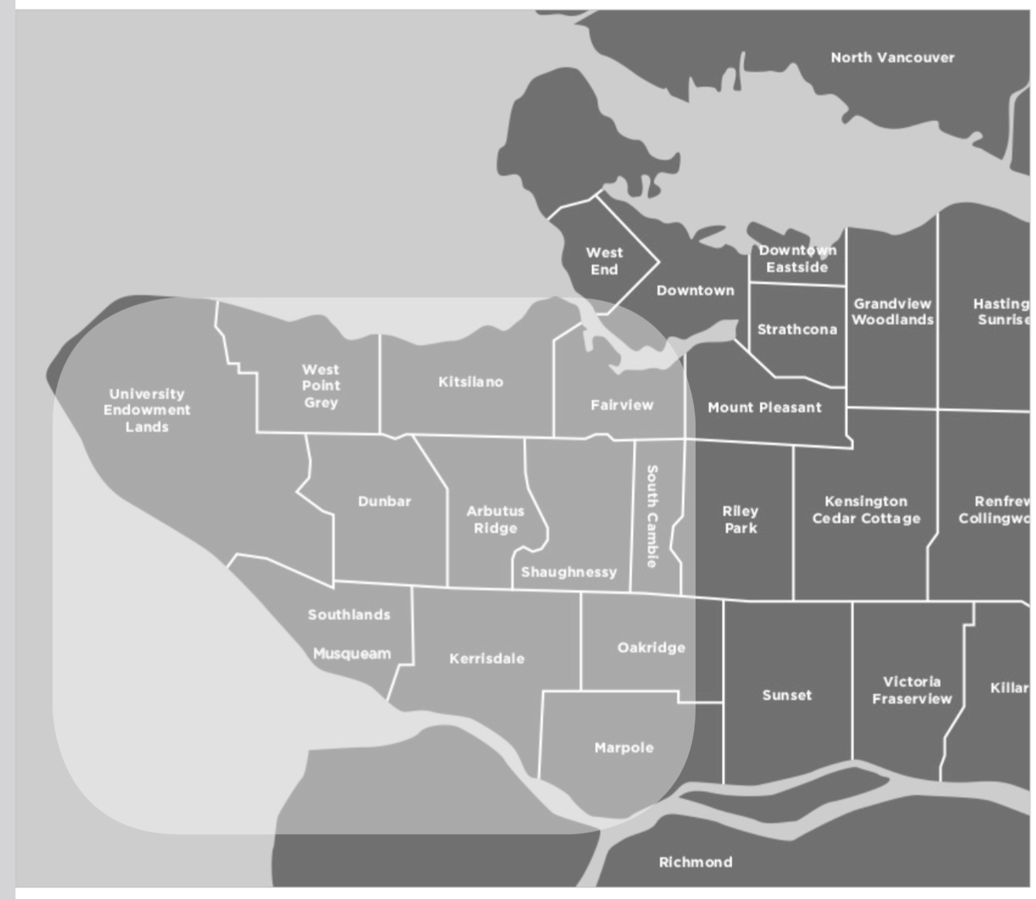

Slide 19
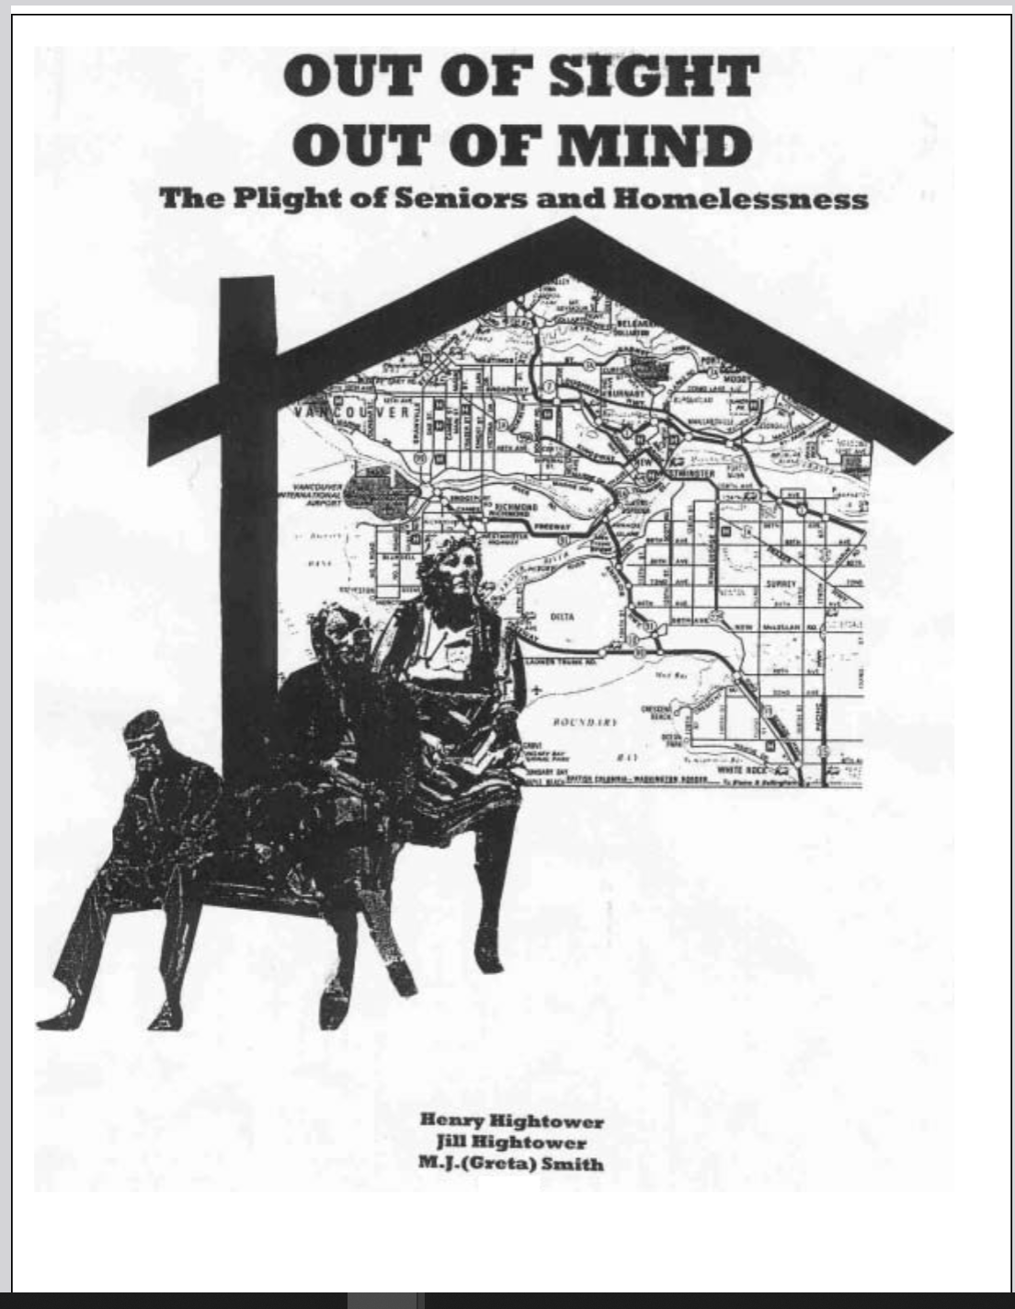

Slide 20
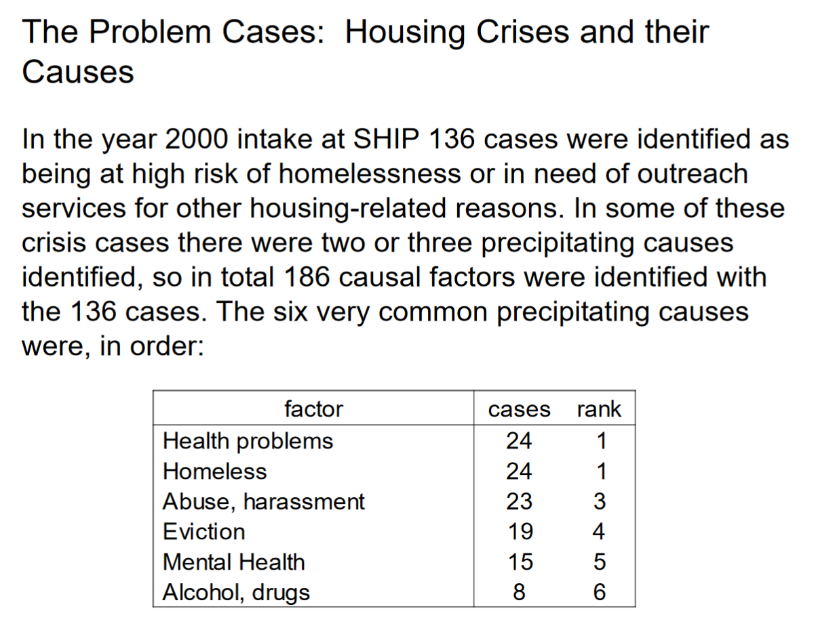

Slide 21
Douglass Todd, Vancouver Sun, Oct. 18, 2018:
“Condominiums have been a game changer in North America … and no more so than in Metro Vancouver.”

Slide 22
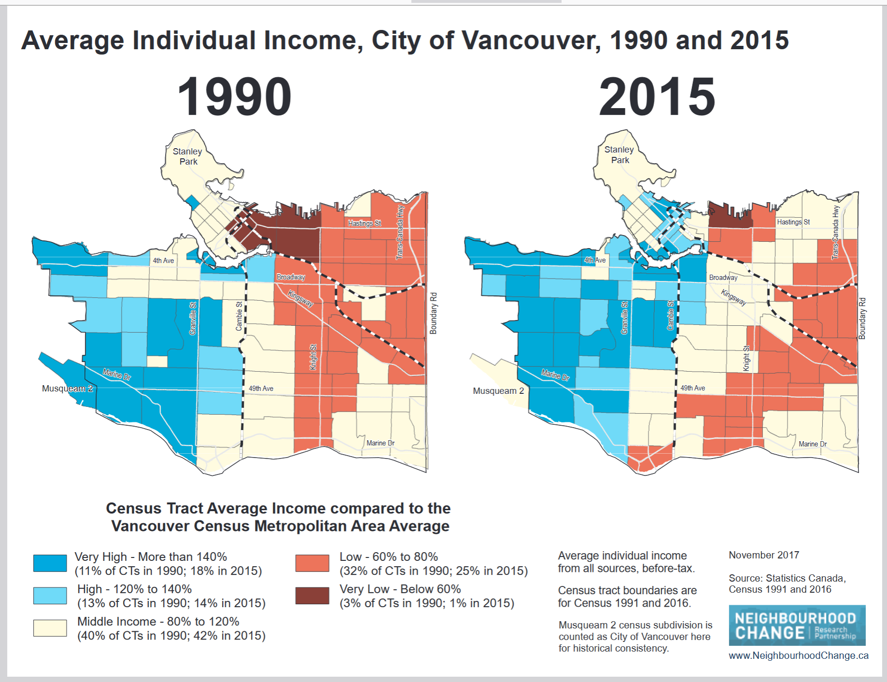

Slide 23
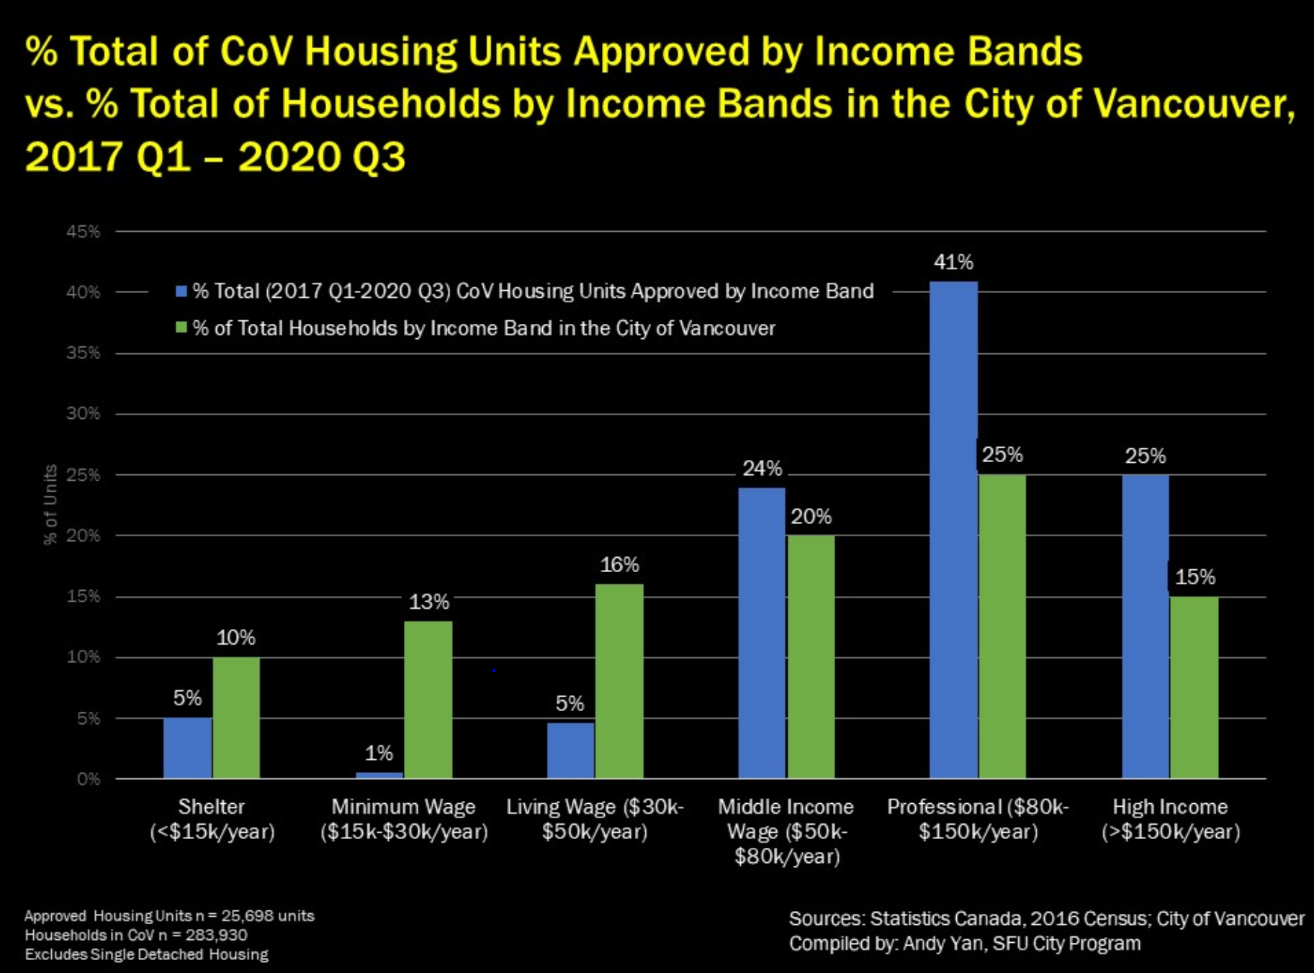

Slide 24
The Financialization of Housing
Functions as speculative wealth storage
Increases liquidity of capital
Creates uneven development and heightened inequality
Inherently unstable; creates spaces of crisis
5. Highly iconic and extremely standardized spaces
From: Matthew Soules (2021) Icebergs, Zombies, and the Ultra Thin: Architecture and Capitalism in the Twenty-First Century, p. 16.

Slide 25
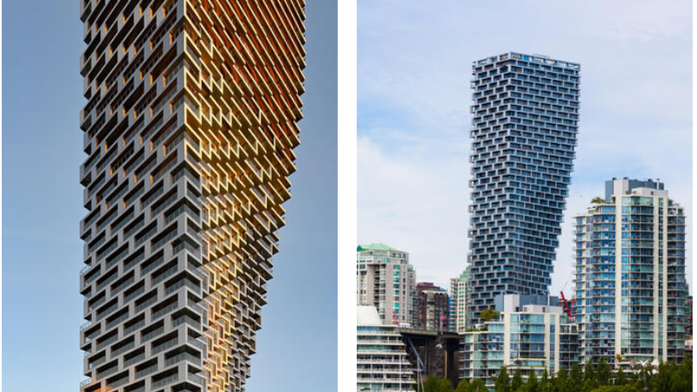

Slide 26
Co-Housing

